Slide 1

Bus Reservation system
Presented By :
Group Id –BE2020A11.
1. Sharvari Birute.
2. Chetana Mahajan.
3.Hemal Sawdekar.

Slide 2
INTRODUCTION
Bus Reservation System is windows based application that works within centralized network. The software program “Bus Reservation System” provides bus transportation system a facility to reserved seats, cancellation of seat and different type of enquiry which need an instant and quick reservation. This app is built for manage and computerized the traditional database, ticket booking ,reserved seats, Ticket booking and tracking bus made travel easy. It maintain all the data of user bus detail, reservation details, booking details, customers detail etc.

Slide 3
Abstract
The objective was two-fold - to ensure that the Customers don’t have to leave the confines of their comfort to book a ticket, and to help them get a ticket when they need it the most. The internet was being voted as a medium people couldn’t do without. PC and net penetration was increasing not only in urban areas, but also in rural India. Also, people were getting used to booking tickets for travel using IRCTC and private airline websites. So, why not buses? Online system provides real time quotations, real time bus booking services for round trips, multiple payment channels, cost comparison, last minute booking, an in-house call center and even home delivery of tickets. Online system provides real time quotations, real time bus booking services for round trips, multiple payment channels, cost comparison, last minute booking, an in-house call center and even home delivery of tickets.

Slide 4
Back-end database
A back-end database is a database that is accessed by users indirectly through an external application .
This is rather than by application programming stored within the database itself or by low level manipulation of the data
A back-end database stores data but does not include end-user application elements such as stored queries, forms, macros or reports.

Slide 5
Front end database
1)Booking
2)Cancelling
3)From:
To:
Date of journey:

Slide 6
S.N O | ITEM | REQUIREM ENT | RESPONSIBLT Y | PLANND DATE | ACTUA L DATE | STATUS
1. | Software | DEV C++ | TEAM | 21/04/2021 | 23/0/2 | Completed
2. | Document | MS WORD | TEAM | 23/04/20 | 23/4/2 | completed

Slide 7
Hardware Requirements:
PC with core 2 duo or more proccessor
512 MB RAM or above.
180 GB Hard Disk or above.
Software Requirements:
Operating system : Windows XP (or) 7.
Dev c++ & Code blocks compilers.
Microsoft word and powerpoint

Slide 8
ALGORITHM:
1) Taking a class named as a.
2) Declaring the variables and arrays as busn[5], driver[10],
arrival[5], depart[5], from[10], to[10], seat[8][4][10].
3) And in public of the class we are giving member functions as
void install();
void allotment();
void empty();
void show();
void avail();
void position(int i);

Slide 9
4) And giving that maximum buses available are 10.
5) And now with respect to installing function we gave few options to enter in the run time which will gives to enter the bus details from back end of the system like bus no, Driver's name, Arrival time, Departure time, from and to .
6) And now with respect to allotment function we can allot seats for customer according to their preferable seat numbers.
7)And the empty function shows that the seats are empty in
the bus.
8) And the show function shows that the how many seats available in the given bus.And which seats are all ready reserved in the bus.

Slide 10
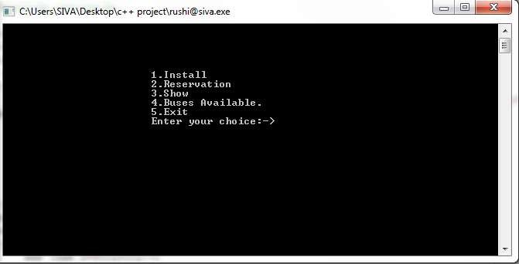
OUT PUT:
Step 1:The first look of the out put will be given as

Slide 11
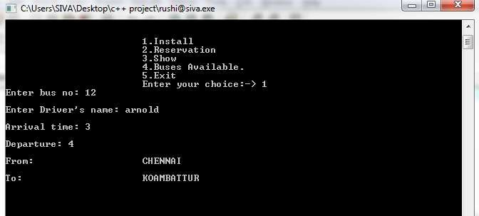
Step 2:
Second step is that we have to install the number of busses that we have to provide for customers and this is done by the back end system and in this function we have to give details of the bus like bus num,Drivers name,Arrival time ,departure time,From and To.

Slide 12
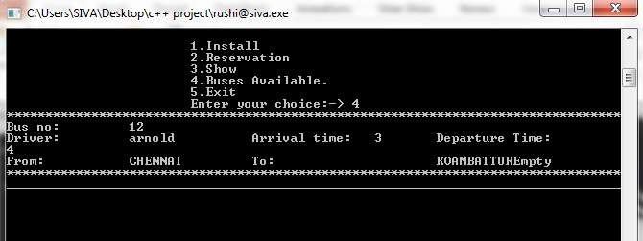
Step 3:
We have to show the user how many busses are available in this travels that’s why we have to display the busses and their routes

Slide 13
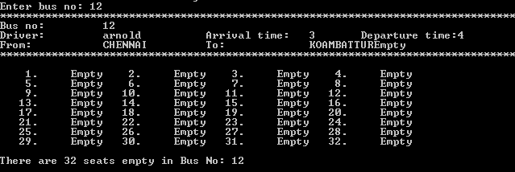
Step 4:
After cheking the routes and the busses in the travels we have to show them that how many seats are empty in the given bus and the max num of seats that they can book.

Slide 14
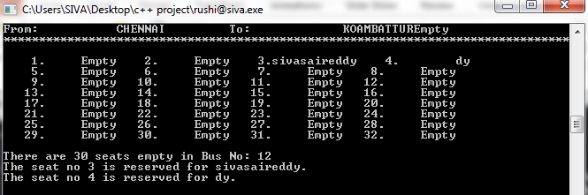
Step 5:
Now after all these conclusions we have to book the ticket for the passenger i.e; according to their opinion we have to book their seats according to the seat numbers they want.And after booking we have to show them that what are the seats they reserved and bus details.

Slide 15
Thank you

